Slide 1
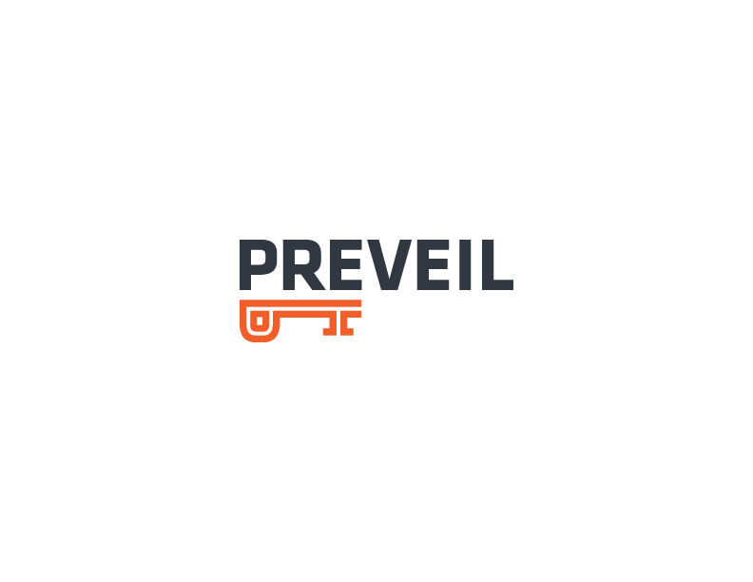
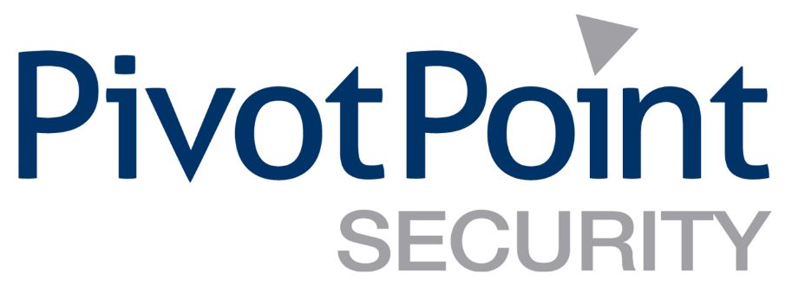
Important Business Decisions for CMMC Compliance
Strategies for protecting FCI, CUI&
other Critical Business Data

Slide 2
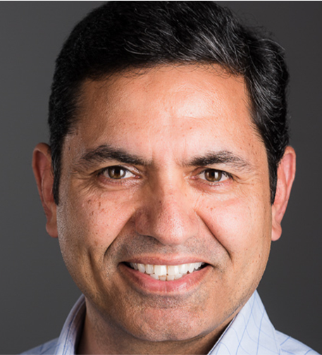
SPEAKERS
JOHN VERRY
SANJEEV VERMA
Managing Partner @ Pivot Point
Co-founder @ PreVeil

Slide 3
Agenda
Protecting CUI is a Business Issue (& an InfoSec Challenge)
Scenario A: Defense is our predominant market
Scenario B: Defense is a good chunk of our business
Scenario C: Defense is an important, but small % of our business
Q & A
Breakout room

Slide 4
Breakout Room
bit.ly/PreVeil

Slide 5
Do you have a vision for how your business will address:
Security
Privacy
Compliance
both inside and outside the DIB?

Slide 6
Scenario Specific Challenges
Heavy reliance on DoD revenue
Significant reliance on DoD revenue
Small reliance on DoD revenue
Defense Co.
Services Inc.
Production Corp.
90% + DoD
Heavy reliance on DoD revenue
1,000+ Employees
Multiple Geographic Locations
Multiple Distinct “Products”
50% DoD
Significant reliance on DoD revenue
250+ Employees
Multiple Geographic Locations
Single “Service”
10% DoD
Significant reliance on DoD revenue
<100 Employees
Single Location
Single Product
Highly Virtualized

Slide 7
Common Challenges for All
IMPACT OF INTERIM RULE
Reporting and/or provable 800-171 conformance ahead of CMMC
November 30 and/or contract renewal for existing 7012
DOD Assessment Methodology/800-171A with POAM’s for all “gaps”
Flow Down (re) clarified (Third Party Risk Management)
You have an obligation to ensure any third parties accessing FCI/CUI are protecting that data at the same level (e.g., SPRS 800-171 or CMMC LX) prior to allowing access
You will need to have evidence (e.g., contracts, proof of conformance) to prove it
CMMC MAY NOT BE ALL INCLUSIVE
How do other DFAR regulations/contractual obligations impact your CMMC efforts (e.g, ITAR, NOFORN)?
Certain forms of CUI (e.g., CTI) can have additional requirements beyond CMMC Level 3. It is critical you review all your contracts to identify and document these requirements (Christian Doctrine)
YOU NEED TO START ON CMMC EARLIER THAN YOU THINK
Passing a CMMC Level 3 Audit will require evidence of “persistent and habitual” execution of practices/processes
Prevailing interpretation is that you will need a 6 month “soak” phase
Queue beginning/expected to form at key chokepoints (e.g., GCC high, Holy Twelve, RPO’s, C3PAOs)
Some Gap Remediation takes time of note to deploy right (e.g., SIEM, MFA, etc.)
NDA EVERYTHING (WHISTLE BLOWERS/ FCA IS A SCARY PROPOSITION)

Slide 8
Defense Co. (90+% DoD Revenue)
800-171 & CMMC are a MASSIVE business risk that requires immediate attention
SPRS & CMMC efforts are an “all hands on deck” exercise
Revisit your understanding of current scope & optimize your future scope
Intelligent enclaving to minimize scope and/or the number of SSPs required can speed certification and reduce implementation/operation costs (multiple locations/”products” can be challenging)
Generally, more 7012/800-171 conforming with internal infosec personnel so a 3rd party gap assess or a CMMC “readiness” assessment may provide max value
Technology changes of note (e.g., email/file sharing migration, MFA, SIEM) are more complex, time consuming, and expensive in larger orgs (start them yesterday)
3rd Party Risk Management is as much a key business issue as it is a security issue
What if key vendors cannot achieve 800-171 and/or CMMC conformance?

Slide 9
Services Inc. (~50% DoD Revenue)
800-171 & CMMC are significant business risks requiring near immediate attention
You need a plan for SPRS and CMMC, ASAP
Generally less 7012 conforming with limited internal infosec personnel, likely best served by starting with scope determination & Risk Assessment (keys to SSP)
Understand your current scope and optimize your future scope
Intelligent enclaving to minimize scope and/or the number of SSPs required can speed certification and reduce implementation/operation costs
Significant benefit to understand/differentiate/strategize security and attestation for both DIB and Commercial
Can operational efficiencies of your Information Security Program offset the the increased cost of CMMC operational controls? Do you have other compliance obligations (e.g., CCPA, PCI-DSS)? Will commercial clients recognize CMMC L3 attestation or require ISO-27001?
More likely you need technology changes of note (e.g., email/file sharing migration, MFA, SIEM) -- minimizing personnel & systems in scope can pay notable dividends

Slide 10
Production Corp. (~10% DoD Revenue)
CMMC is (potentially) a small business risk
Need to determine if SPRS is necessary & whether CMMC is a worthwhile investment
Current/potential revenue?
Current/ongoing CMMC costs?
Current security and/or attestation posture?
Barrier to entry (& to remain) for competitors?
Value of security attestation to your non DIB clients?
Generally less 7012 conforming with limited internal infosec personnel, likely best served by starting with scope determination &
Risk Assessment (keys to SSP)
Understand your current scope & optimize your future scope
Are the products you are selling COTS (Commercial Items sold in substantial quantities ... in the commercial marketplace …
and offered to the government … without modification)
Significant benefit to understand/differentiate/strategize security and attestation for both DIB & Commercial
Technology changes of note (e.g., email/file sharing migration, MFA, SIEM, re-enclaving) can be easier/faster to implement

Slide 11
Simple. Encrypted. Compliant
Email & File Sharing for Business
Notes:
Sanjeev Verma – Co-Founder & Chairman, Preveil: end to end email encryption and filesharing tool
Dave Stevens, President of Kapu Technologies and Cybersecurity Instructor at UH Kapiolani Community College, Our NDIA Hawaii Vice President, and an InfraGard Hawaii member
Gordon Bruce, President, GJB and Associates, CMMC Registered Provider Organization and Registered Practitioner, also an NDIA Hawaii member and Infragard Hawaii Member

Slide 12
How Can My Organization?
Enhance Email and File Security with End to End Encryption
Become CMMC L3, ITAR Compliant Simply, Inexpensively
Help my Suppliers become CMMC Compliant
Improve Self Assessment Score for DFARS Interim Rule
Notes:
Sanjeev Verma – Co-Founder & Chairman, Preveil: end to end email encryption and filesharing tool
Dave Stevens, President of Kapu Technologies and Cybersecurity Instructor at UH Kapiolani Community College, Our NDIA Hawaii Vice President, and an InfraGard Hawaii member
Gordon Bruce, President, GJB and Associates, CMMC Registered Provider Organization and Registered Practitioner, also an NDIA Hawaii member and Infragard Hawaii Member

Slide 13
Cybersecurity Maturity Model Certification Domains
Access Control
Asset Management
Audit & Accountability
Awareness & Training
Configuration Management
Identification & Authentication
Incident Response
Maintenance
Media Protection
Personnel Security
Physical Protection
Recovery
Risk Management
Security Assessment
Situational Awareness
System & Communications Protection
System & information Integrity
Notes:
Sanjeev Verma – Co-Founder & Chairman, Preveil: end to end email encryption and filesharing tool
Dave Stevens, President of Kapu Technologies and Cybersecurity Instructor at UH Kapiolani Community College, Our NDIA Hawaii Vice President, and an InfraGard Hawaii member
Gordon Bruce, President, GJB and Associates, CMMC Registered Provider Organization and Registered Practitioner, also an NDIA Hawaii member and Infragard Hawaii Member

Slide 14
Systems + Policies + Processes = CMMC Compliance
Acces Control
Asset Management
Audit & Accountability
Awareness & Training
Configuration Management
Mostly Systems: PreVeil
Identification Authentication
Incident Response
Maintenance
Media Protection
Personnel Security
Both PreVeil & Processes
Physical Protection
Recovery
Risk Management
Security Assessment
Situational Awareness
Mostly Policies & Processes
System & Communications Protection
System & information Integrity
Notes:
Sanjeev Verma – Co-Founder & Chairman, Preveil: end to end email encryption and filesharing tool
Dave Stevens, President of Kapu Technologies and Cybersecurity Instructor at UH Kapiolani Community College, Our NDIA Hawaii Vice President, and an InfraGard Hawaii member
Gordon Bruce, President, GJB and Associates, CMMC Registered Provider Organization and Registered Practitioner, also an NDIA Hawaii member and Infragard Hawaii Member

Slide 15
Two Leading Choices for Systems to Achieve CMMC L3
Microsoft GCC High | PreVeil
Exorbitantly Expensive | Inexpensive: Typically 75% Lower Cost
Remove O365/GSuite, Replace with GCC | Keep O365, GSuite. Overlay with PreVeil
Months of Disruption to Deploy. | Easy Deployment In a Day.
Deploy to all Users must use GCC High | Deploy only to users who handle CUI
Adequate but Mediocre Security based on Legacy Architecture | State of the art, Zero Trust Security. All Data is End to End Encrypted
Notes:
Sanjeev Verma – Co-Founder & Chairman, Preveil: end to end email encryption and filesharing tool
Dave Stevens, President of Kapu Technologies and Cybersecurity Instructor at UH Kapiolani Community College, Our NDIA Hawaii Vice President, and an InfraGard Hawaii member
Gordon Bruce, President, GJB and Associates, CMMC Registered Provider Organization and Registered Practitioner, also an NDIA Hawaii member and Infragard Hawaii Member

Slide 16
CUI on Traditional Mail Servers
Company B
Mail Server
Internet
Company A
Mail Server
Company C
Mail Server
Company D
Mail Server
In Traditional Systems, like GCC High, O365, GSuite the Server can see Unencrypted data
So can the attacker

Slide 17
End-to-end Encryption
Encrypt
PreVeil Server
Company B
Decrypt
AWS GovCloud
Company C
Company A
Company D

Slide 18
Eliminate Password Vulnerabilities with Keys
Traditional System
PreVeil
Server
Server
Password
Unguessable Key stored on device required for decryption and user authentication
Attacker can not log in remotely
Password
Attacker obtaining password can log in remotely
Attacker

Slide 19
Trusted Communities
X
X
Organization
Suppliers
Customers

Slide 20
Get In Touch With Us
John Verry
John.verry@pivotpointsecurity.com
Sanjeev Verma
sanjeev@preveil.com

Slide 21
Breakout Room
bit.ly/PreVeil

