Slide 1

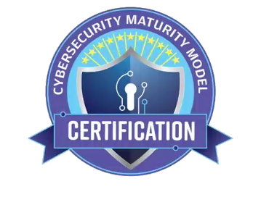









Simplifying CMMC & DFARS 7012 Compliance
Solving the Puzzle for Small Business
From DFARS 7012 to CMMC Certification

Slide 2

About Coalfire Federal
Coalfire Federal provides cybersecurity services to government and commercial organizations helping them protect their mission-specific cyber objectives.
Coalfire Federal is the leading FedRAMP 3PAO, a CMMC C3PAO and CMMC RPO and offers a full spectrum of cybersecurity risk management and compliance services
About Stuart Itkin
Coalfire Federal VP CMMC and FedRAMP Assurance
Previously VP Product Management and Marketing at Exostar, Global CMO at CEB
Executive roles in several cybersecurity businesses
Lead mentor at MACH 37 cyber product accelerator

Slide 3

About PreVeil
PreVeil is a simple, inexpensive and secure SaaS platform for storing and sharing CUI and ITAR data in email and files.
Designed for the enterprise, PreVeil is used by leading defense contractors for CMMC compliance, Supply Chain Collaboration and Incident Response.
About Randy Battat
Co-founder and CEO of PreVeil since 2015
Previously, CEO of Airvana
Led teams at Motorola and Apple
BS in Electrical Engineering, Stanford University

Slide 4


About DTC Global
Focused on DoD Cyber Threat since 2006
Led DoD’s First Cyber CI Insider Threat/FIST Program
Operationalized +$ 3.5B in Transformative Globally Distributed Technologies
Cross-Discipline/Horizontal/Vertical Platform & Systems Integration
Industry Trenches ITAR/DFARS/CMMC
  Large Global Prime Contractors Supply Chain Risk to Small/Micro Businesses
  Clients: $46.8B Market Cap, 235k Employees, 300-325k Endpoints
  Industry Thought Leaders since 2015
About Regan edens
Chief Transformation & Compliance Officer
Director, Board of Directors CMMC Accreditation Body
Chartered by DoD to Manage CMMC Certification
Chairman of Standards Management Committee
Vice Chairman of Training Committee
CMMC Certified Master Instructor
Led Training for CMMC Certified Provisional Assessors

Slide 5
AGENDA
Regan Edens
  10 Tasks to get you started with CMMC compliance
  Critical areas for focus
  5 Critical enablers for compliance success
Randy Battat
  Cloud-based Encrypted File Sharing & Email
Q&A
Breakout

Slide 6
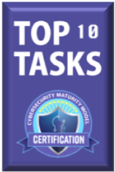
Solve the Puzzle: Top 10 Tasks
From 130 Practices, 409 Assessment Objectives
Your Path to Compliance Begins HERE…
1) Conduct required tasks such as RSA, POA&M, and document them in SSP.
Identify and properly mark the types of restricted information (CUI/FCI) to needed to conduct services, deliver products, and parts.
3) Identify the sources of the restricted US DoD information; understand
where it is developed within your company; and understand where the
restricted information flows within the network and employee workflows.
4) Restrict, segregate, handle, and safeguard the information, documents,
and parts.
5) Develop, modify, and sustain policies, workflow procedures, and network
devices and activities that involve the restricted DoD information.

Slide 7
Solve the Puzzle: Top 10 Tasks
Your Path to Compliance Continues…
6) Train personnel to understand the risks, policies and procedures
required to sustain the requirements.
Ensure impacted portions of your supply chain understand
and meet requirements.
8) Monitor, enforce, document, and audit requirements.
9) Prepare for third party certification with 100% conformity.
10) Sustain requirements and report misuse of CUI, network or other
incidents placing or potentially placing the confidentiality of the
information at risk.

Slide 8
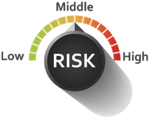
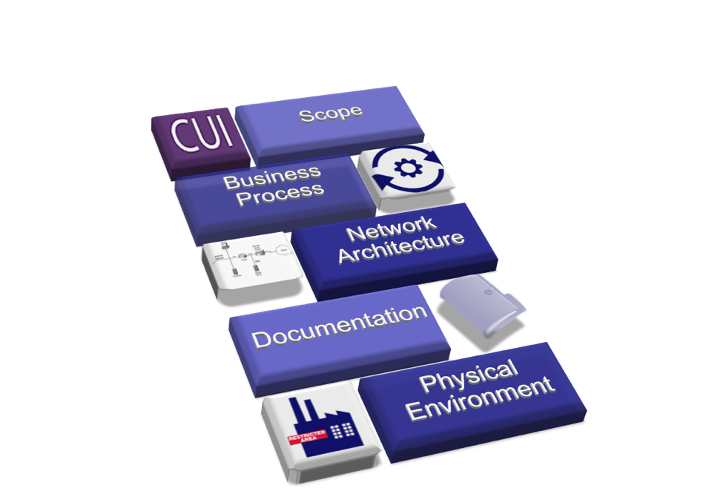
Focus on the Hardest Parts
Critical Focus Areas
Requirements Follow the Data (CUI/FCI)
Data Flow Determines Scope
Compliant Business Processes
Secure Network & Compliant Architecture
Detailed Documentation
Controlled Environment
Your Employees, Trained & Knowledgeable
Your Supply Chain & Subcontractors

Slide 9
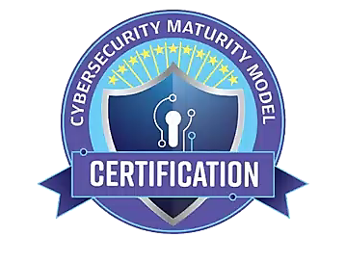
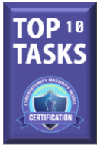

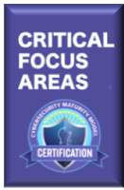


Be $mart: Solve the Puzzle with Help
C
r
i
t
i
c
a
l
E
n
a
b
l
e
r
s
R
e
l
i
a
b
l
e
E
x
p
e
r
t
i
s
e
&
G
u
i
d
a
n
c
e
E
x
p
e
r
i
e
n
c
e
d
C
o
n
s
u
l
t
a
n
t
s
&
I
n
t
e
g
r
a
t
o
r
s
C
o
n
t
r
o
l
t
h
e
F
l
o
w
C
U
I
&
L
i
m
i
t
S
c
o
p
e
L
i
m
i
t
P
e
o
p
l
e
,
D
e
v
i
c
e
s
,
A
p
p
l
i
c
a
t
i
o
o
n
s
f
C
U
I
D
a
t
a
M
a
n
a
g
e
m
e
n
t
C
l
o
u
d
S
e
r
v
i
c
e
P
r
o
v
i
d
e
r
s
&
S
e
r
v
i
c
(
e
s
E
m
a
i
l
/
S
t
o
r
a
g
e
)
C
U
I
W
o
r
k
f
l
o
w
M
a
t
c
h
e
s
R
e
a
l
i
t
y
T
r
a
i
n
P
e
o
p
l
e
o
n
P
r
o
c
e
d
u
r
e
s
&
P
o
l
i
c
i
e
s
E
n
g
a
g
e
S
u
p
p
N
O
W
l
y
C
h
a
i
n
$
m
a
r
t
S
C
S
t
r
a
t
e
g
i
e
s
R
e
d
u
c
e
R
i
s
k

Slide 10

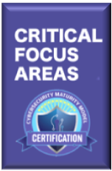
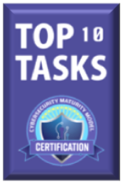
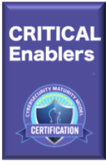
Be $mart: Solve the Puzzle with Help

Slide 11

CUI/FCI for CMMC Compliance:
Cloud-based Encrypted File Sharing & Email

Slide 12
CMMC Domains: Policies, Processes, Systems
Access Control
Asset Management
Audit & Accountability
Awareness & Training
Configuration Management
Mostly Systems
Identification & Authentication
Incident Response
Maintenance
Media Protection
Personnel Security
Both Systems & Processes
Physical Protection
Recovery
Risk Management
Security Assessment
Situational Awareness
Mostly Policies & Processes
System & Communications Protection
System & information Integrity

Slide 13
Systems Considerations
Compliance
Deployment options
Security
Ease of use & adoption
Total cost of ownership

Slide 14
PreVeil: Simple Way To Enhance Cybersecurity
End-to-end encrypted file sharing & email for CUI or ITAR-restricted data
Addresses CMMC requirements for handling CUI in files & messages
Easy to deploy — no modifications required to existing IT infrastructure
Easy to use
Fraction of the cost of alternatives

Slide 15
Demonstration

Slide 16
PreVeil Security

Slide 17

Traditional File & Mail Servers
Plain Text
Plain Text
Company B
Server
Internet
Company A
Server
Plain Text
Company C
Server
Plain Text
Company D
Server

Slide 18

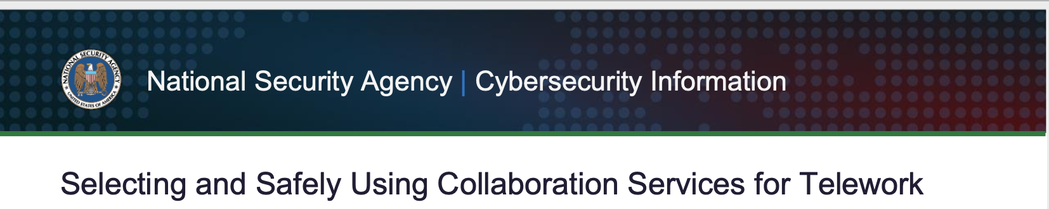
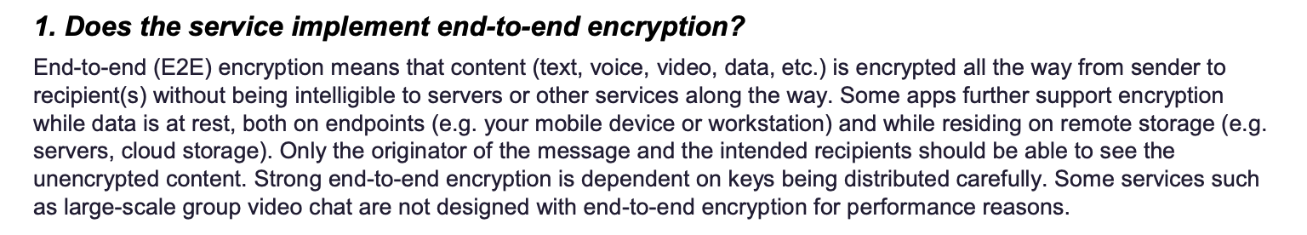
End-to-end Encryption
Encrypt
PreVeil Server
Company B
Decrypt
Company C
Company A
Company D

Slide 19

Passwords vs. Keys
Traditional System
PreVeil
Server
Server
Password
Key stored on device required for decryption
Password
Attacker obtaining password can log in remotely
Attacker

Slide 20






Administrative Vulnerabilities
Traditional System
Any admin can perform sensitive operations:
Reset passwords
Export data
Delete users
And so can an attacker
PreVeil
Admins can perform sensitive functions only with after being authorized by an “approval group.”
Example — Exporting Data:
Encrypted
Decrypted
Server
Server
Files & Emails
Admin
Admin
Exported Data
Attacker
Exported Data
Approvers

Slide 21




External Access Control
Traditional System: Open to the Internet
PreVeil’s Trusted Communities
X
X
Internet
Suppliers
Organization
Organization
Customers
Suppliers
Customers
Attackers

Slide 22
Key Takeaways
Not all cloud services are compliant for CUI & ITAR data
Consider the next generation of cybersecurity
Easy to use and deployment are critical to adoption

Slide 23
Q & A

Slide 24

FINIS
coalfirefederal.com
dtcglobal.us
preveil.com
Stuart.itkin@coalfirefederal.com
reganedens@dtcglobal.us
rbattat@preveil.com
603-892-0538
443.910.3159
857-353-6480

Slide 25
Breakout

