Slide 1
Launch Your
CMMC Compliance:
Guidance From an Upcoming C3PAO
Moderator:
Casandra McMahon, Security Analyst, CMMC-AB RP, RSI Security
Panelists:
Mohan Shamachar, Senior Security & Privacy Advisor, CMMC-AB RP, RSI Security
Gregg Laroche, VP, Product Management, PreVeil

Slide 2
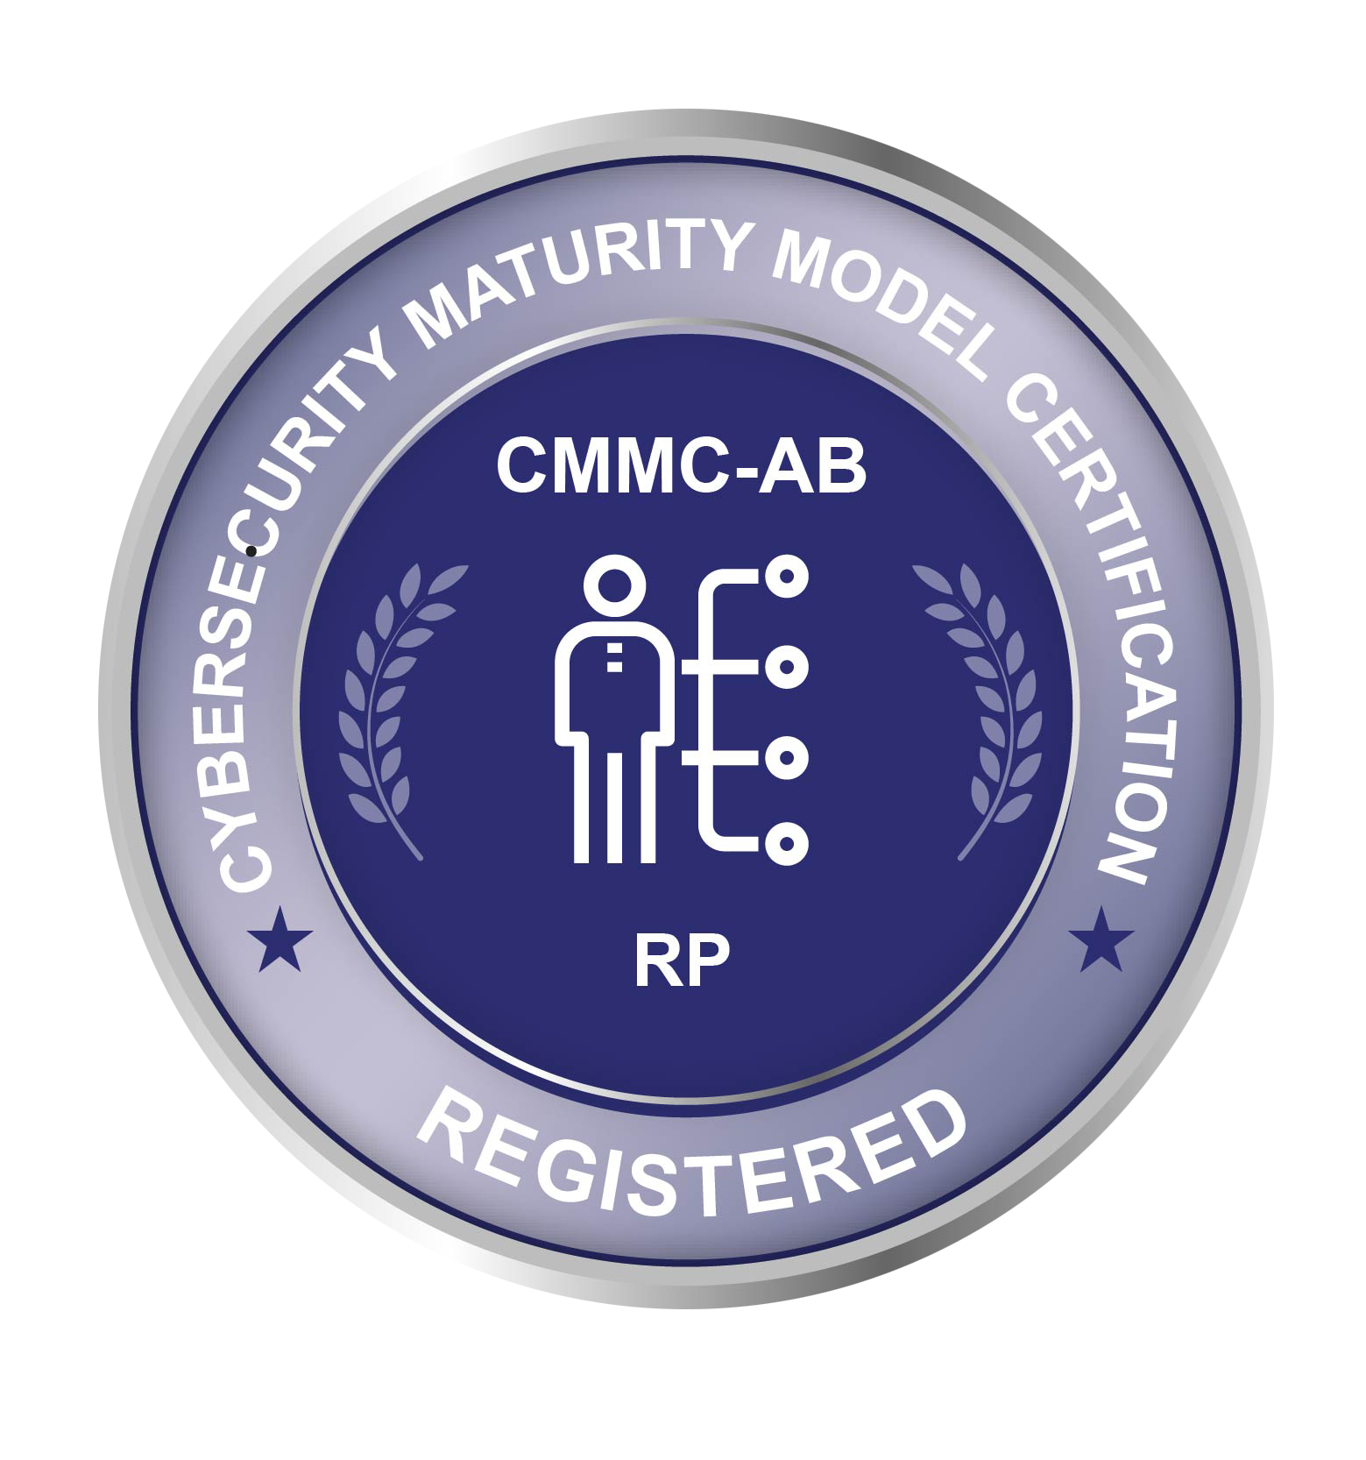
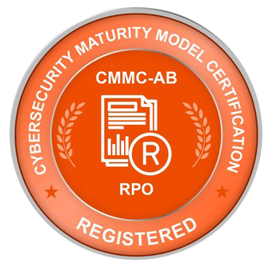
About RSI & PreVeil
Encrypted email solution
Encrypted file sharing solution
Protects CUI
Fulfills key CMMC requirements for Level 3+
Simple, Inexpensive, & Secure technology
CMMC-AB Registered Provider Organization (RPO)
Qualified Team of CMMC-AB Registered Practitioners
C3PAO certification soon-to-be announced
Compliance frameworks and cybersecurity experts
Our Success is in Securing Yours

Slide 3
Meet Our Panelists
Mohan Shamachar
Senior Security & Privacy Advisor, RSI Security
CMMC-AB Registered Practitioner
Upcoming CP/CA
Gregg Laroche
VP Product Management, PreVeil
Casandra McMahon
Security Analyst, RSI Security
CMMC-AB Registered Practitioner
Upcoming CP

Slide 4
Webinar Agenda
CMMC Implementation Timeline
Maturity vs Implementation
CMMC Domains: Policies, Processes and Systems
CMMC Assessment Process
Audience Questions and Answers
Breakout Session

Slide 5
CMMC Implementation Timeline
Crawl-Walk-Run approach
Gradual increase of contracts requiring CMMC certification by FY25

Slide 6
CMMC Maturity Model Levels

Slide 7
CMMC Domains:
Policies, Processes, Systems
Access Control
Asset Management
Audit & Accountability
Awareness & Training
Configuration Management
Mostly Systems
Identification & Authentication
Incident Response
Maintenance
Media Protection
Personnel Security
Both Systems & Processes
Physical Protection
Recovery
Risk Management
Security Assessment
Situational Awareness
Mostly Policies & Processes
System & Communications Protection
System & Information Integrity

Slide 8
CMMC Assessment Timeline

Slide 9
Questions?

Slide 10
Contact
Casandra McMahon
casandram@rsisecurity.com
Mohan Shamachar
mohan@rsisecurity.com
Gregg Laroche
gregg@preveil.com

Slide 11
Breakout

