Slide 1
Building a Winning Cybersecurity Program How to maximize your CMMC investment
March 9, 2021

Slide 2
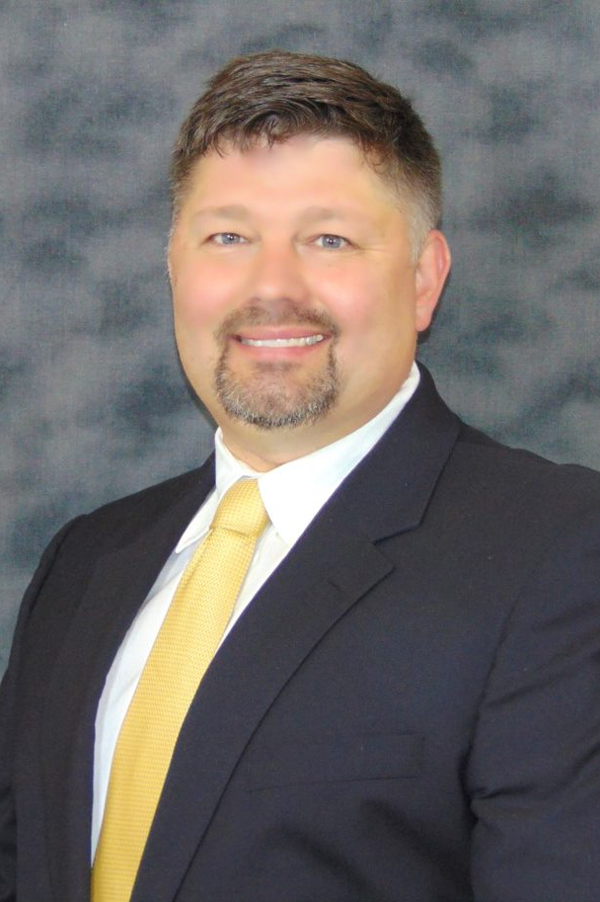
About Cliff Neve
COO, MAD SECURITY
26+ Years in IT and Cybersecurity
Established multiple Security Operations Centers
Supported a Fortune 5 and several Fortune 200 companies
Retired Coast Guard Commander

Slide 3
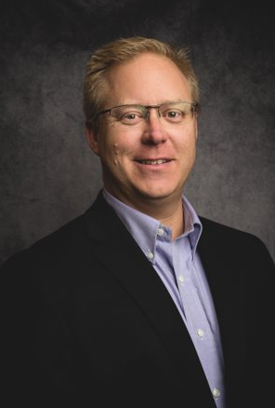
About Scott McDaniel
VP Technology, SIMPLE HELIX
24 Years Experience in Telecommunications and IT
MBA , Auburn University
BS Electrical Engineering, Auburn University

Slide 4
About Sanjeev Verma
Co-founder & Chairman, PREVEIL
Co-founder & Chairman @ PreVeil since 2015
Previously, co-founder Airvana
Business leadership roles, Motorola
MBA, MIT Sloan School of Management
BS Electrical Engineering, Delhi College of Eng.

Slide 5
Agenda
Simple Helix
Going from DFARS to CMMC
Simple Helix + MAD Security
5 Steps to CMMC Compliance​
PreVeil
Cybersecurity Practices & Technologies for Protecting CUI
Q&A
Breakout

Slide 6
Going from DFARS to CMMC

Slide 7
WHY IS THE GOVERNMENT REQUIRING THIS?​
Cyber-attack is now a $6 trillion industry and growing exponentially.​
The biggest DOD data losses happened in the DIB.​
WHY YOU SHOULD WANT TO ACT?​
Safeguard your intellectual property​
It’s a non-negotiable part of your contract
Get started now
WHY YOU NEED TO PREP FOR CMMC
​
Dfars codifies CMMC. What it requires
-→ Score matters. Get to 110 now and 130 with CMMC
Not a “one size fits all” standard like DFARS
Phased rollout schedule for the next 4 years​
100% of your investment in DFARS 7012 carries forward!​
​All of this helps better control your costs!​

Slide 8
4 Steps to CMMC Compliance

Slide 9
STEP 1:
BASELINING
Develop a focused plan with a Consultant ​
Baselining - What are my requirements for compliance? ​
Scoping CUI environment and how you’ll protect it
Gap assessment ​​
POAM
These can be completed in-house or outsourced to companies like MAD Security
*identify gaps companies are seeing and challenges

Slide 10
STEP 2:
IMPLEMENTATION
BASELINING
Executing the POA&M ​
Closing the GAPs​
Implementing new​;
Procedures​​
Training​
Tools​
​This can be completed in-house or outsourced to a company like Simple Helix.

Slide 11
STEP 3:
ENACT
IMPLEMENTATION
Monitoring ​
Training​
Company culture will change​
Operate per the SSP​
Resolving Issues​
Take time to work through SSP and adjust accordingly​
​
This must be done by the contractor with sporadic involvement from outsourced service companies
BASELINING

Slide 12
STEP 4:
ASSESSMENT
ENACT
Audit​
C3PAO conducted ​
Present proof of controls met to assessor ​
Continuous Improvement​
Restart compliance cycle
IMPLEMENTATION
BASELINING

Slide 13
Cybersecurity Practices & Technologies for Protecting CUI

Slide 14
Q&A

Slide 15
Sanjeev Verma
sanjeev@preveil.com
1 (857) 353-6612
Cliff Neve
cneve@madsecinc.com
1 (888) 623-7324
Scott McDaniel
info@simplehelix.com
1 (256) 704-1041

Slide 16
Breakout

