Slide 1
PreVeil Encrypted Email & Document Collaboration
Simple. Secure. Inexpensive. Compliant.

Slide 2
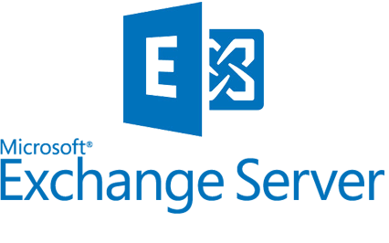
“Zero Trust” Cybersecurity
The increasing complexity of current and emerging network environments has exposed the lack of effectiveness of traditional network cybersecurity defenses.
Traditional perimeter-based network defenses with multiple layers of disjointed security technologies have proven themselves to be unable to meet the cybersecurity needs due to the current threat environment.
The Zero Trust model eliminates trust in any one element, node, or service by assuming that a breach is inevitable or has already occurred…
NSA strongly recommends that a Zero Trust security model be considered for all critical networks …and Defense Industrial Base critical networks and systems...
NSA Release Feb 25, 2021

Slide 3
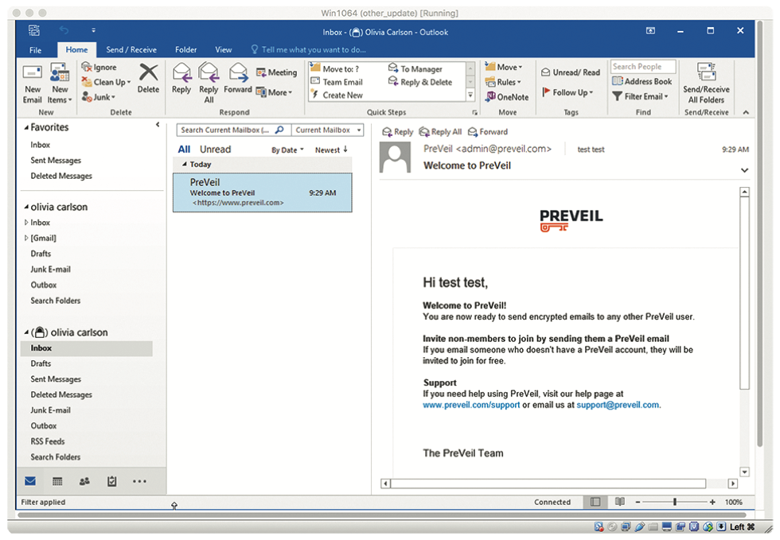
PreVeil Drive & Mail: Zero Trust CUI, ITAR
Document Collaboration
Encrypted Messaging
Integrated with file system (File Explorer/Mac Finder)
Works with Outlook & GMail
FedRAMP Baseline Moderate Equivalent, FIPS 140-2, All Data Stored on FedRAMP High AWS Gov Cloud

