Slide 1


Co-brandable PreVeil Overview Slides
November 2025
50+ Perfect 110/110 Scores and counting!
Dan Martel
Partner Marketing Manager, PreVeil
dmartel@preveil.com

Slide 2
[Your Company] & PreVeil
PreVeil
[Your Company]
[Your Company] Preferred Tech Partner providing encrypted Email + File Sharing for Defense and Regulated Industries
Provide pre-filled documentation and assessment prep tools which saves time preparing for CMMC assessment
Proven: 50+ Contractors have received 110/110 CMMC scores leveraging PreVeil

Slide 3
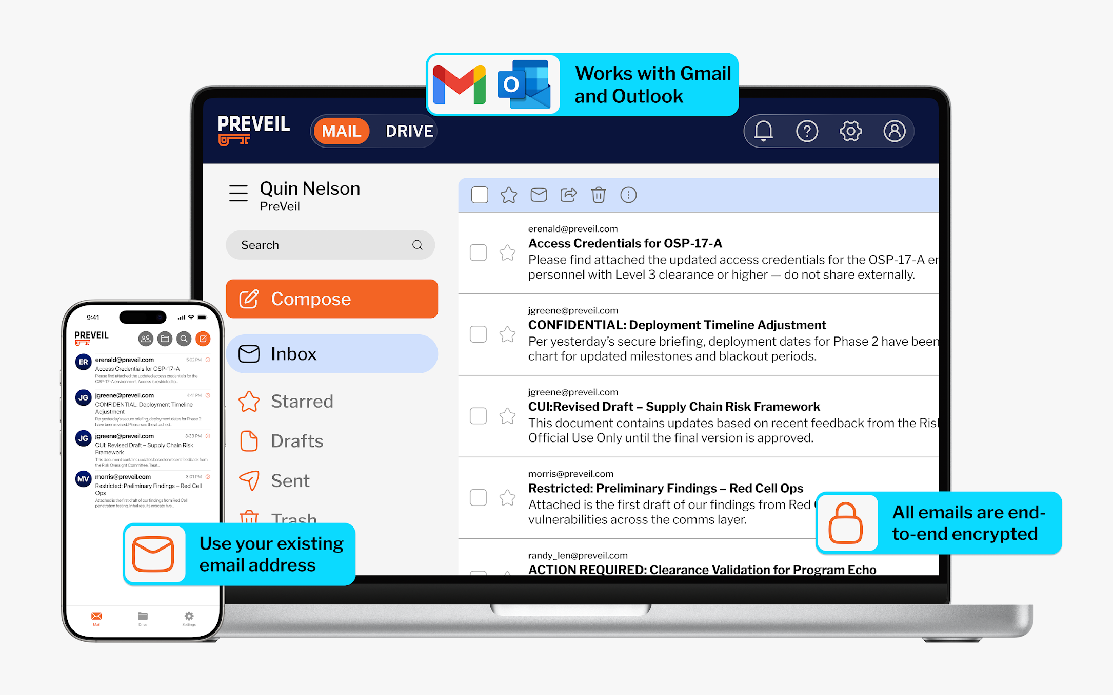
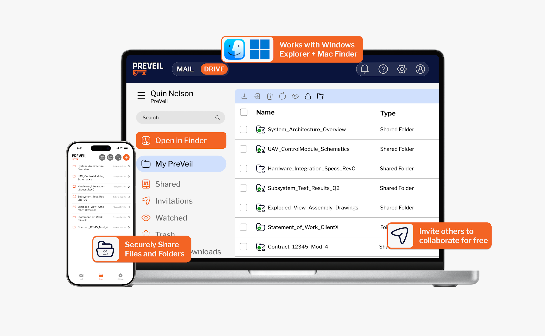

PreVeil Email + Drive: Simple, Secure, Compliant
Your logo here
PreVeil Drive
PreVeil Email
Meets DoD FedRAMP Certified, FIPS 140-2, DFARS c-g and ITAR requirements
PC Magazine Editors Choice for Encrypted Email & File Sharing 5 Years in a Row!
CONFIDENTIAL & PROPRIETARY
4

Slide 4





Why PreVeil
Your logo here
Easy to Deploy
and Use
Proven
Compliance
Save 75% vs Alternatives
Deploys in a few hours using existing email addresses
Integrated w/ Outlook, Gmail, Windows Explorer, Mac Finder
Meets all DoD DFARS & NIST/CMMC requirements
2,000+ DIB customers,
50+ with 110/110 CMMC assessment scores
Minimize the compliance boundary to only users handling CUI
Leverage PreVeil’s Compliance Accelerator
Alternatives
PreVeil
License + Documentation Cost
CONFIDENTIAL & PROPRIETARY
3

Slide 5
PreVeil Benefits vs. GCC High
Your logo here
Save 80%+ with PreVeil
Additional PreVeil Benefits
Deployment costs: PreVeil deploys in as little as 1-2 hours
License structure: PreVeil’s licenses are lower cost and PreVeil only requires licenses for users handling CUI as opposed to enterprise-wide deployments.
Streamlined Documentation: PreVeil provides detailed compliance documentation outlining exactly how PreVeil supports meeting each control, which can save hundreds of hours of time and associated costs
Supply Chain Collaboration: easily communicate with suppliers and 3rd parties with PreVeil’s freemium model.
Prevent CUI Leakage: Easily restrict flow of CUI to authorized contacts.
ITAR Support: PreVeil complies with ITAR E2E encryption requirements and meets carveout criteria, saving steps to compliance
Cross Platform Support: Supported on PC, MAC, iOS, & Android
Storage on AWS Gov Cloud: PreVeil Email + Drive automatically encrypt and store data on Amazon’s FedRAMP High GovCloud

Slide 6
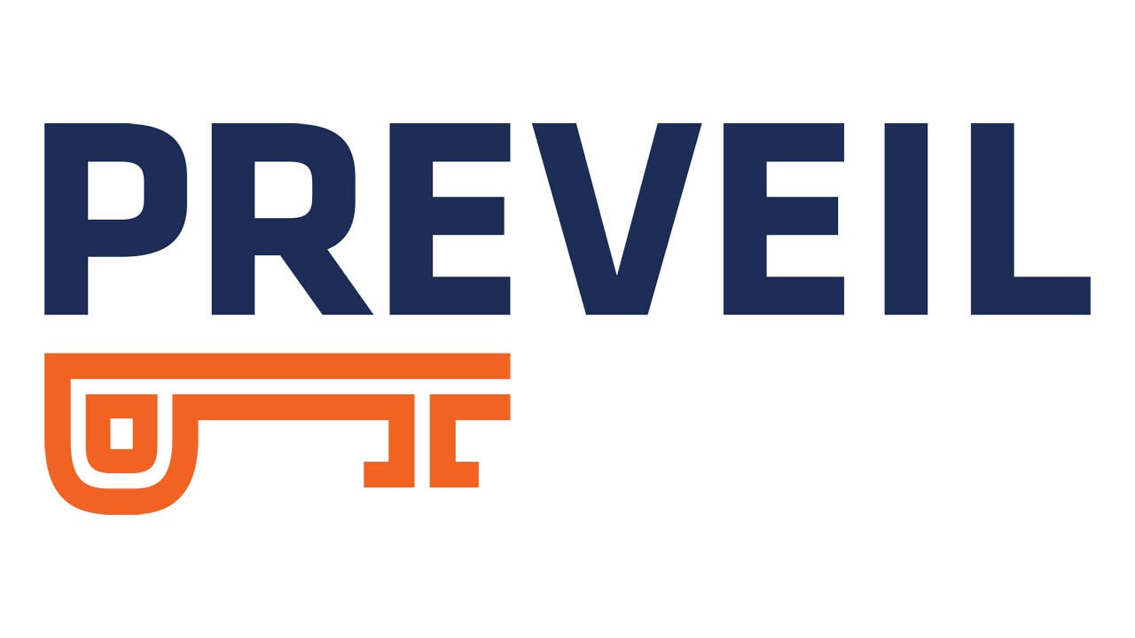
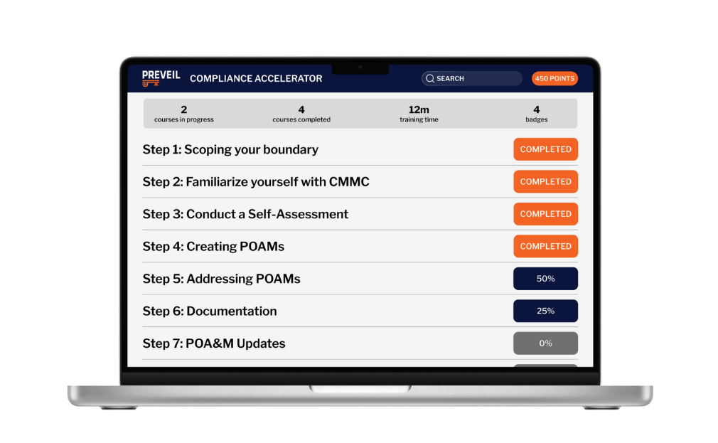

Your logo here
Simple, Secure, Compliant
Email + File Sharing
Assessment-Ready CMMC/NIST
Documentation with 1x1 Support
The Compliance Accelerator
PreVeil Certified RPO, C3PAO, MSP
Partner Community
FedRAMP Certified
Meets DFARS c-g
FIPS 140-2 Validated
ITAR Compliant
Provides inherited or partial support
for 102 of 110 NIST/CMMC controls
Access to 60+ assessor-validated compliance documents proven in CMMC assessments and 30 instructional videos
Detailed content to help address
all 110 of 110 controls
Save time and money with leading industry partners that know PreVeil
Expert guidance
on meeting 110 of 110 controls
CONFIDENTIAL & PROPRIETARY
4

Slide 7

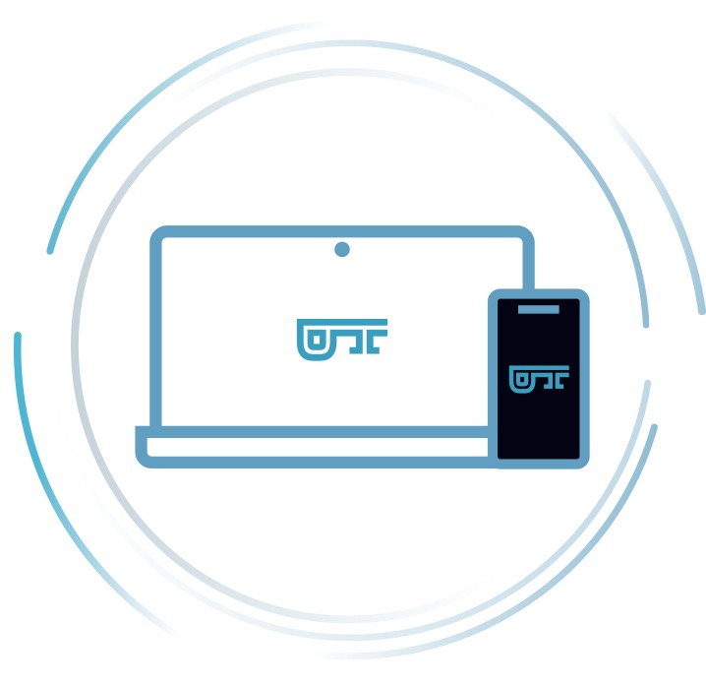


PreVeil’s Zero Trust Security Advantage
Your logo here
End-to-end Encryption
No Passwords
No Central Point of Attack
Trusted Community
No attacker can ever decrypt your CUI
Authentication via
secure cryptographic keys
Distributed trust for invasive Administrative actions
Share CUI only with
trusted 3rd parties
CONFIDENTIAL & PROPRIETARY
5

Slide 8
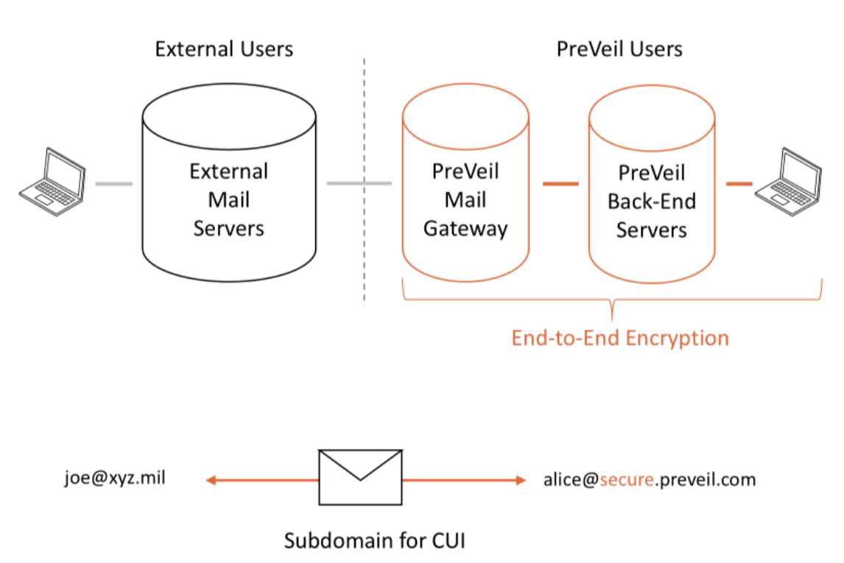
PreVeil Email Gateway
Your logo here
Enables organizations to share CUI with customers and business partners that prefer to send and receive secure email via their own compliant email system.
Works with any 3rd party email address
Secure, encrypted bi-directional email transport
NIST/CMMC compliance boundaries are maintained for both sender and receiver
Seamless for your users – works within existing PreVeil accounts
Easy for 3rd party users – they use their regular email service (assumed compliant)
Supports TLS and standard ECA certificates
Works with existing PreVeil accounts
Operates inside the customer firewall so PreVeil has no access to data
CONFIDENTIAL & PROPRIETARY
8

Slide 9
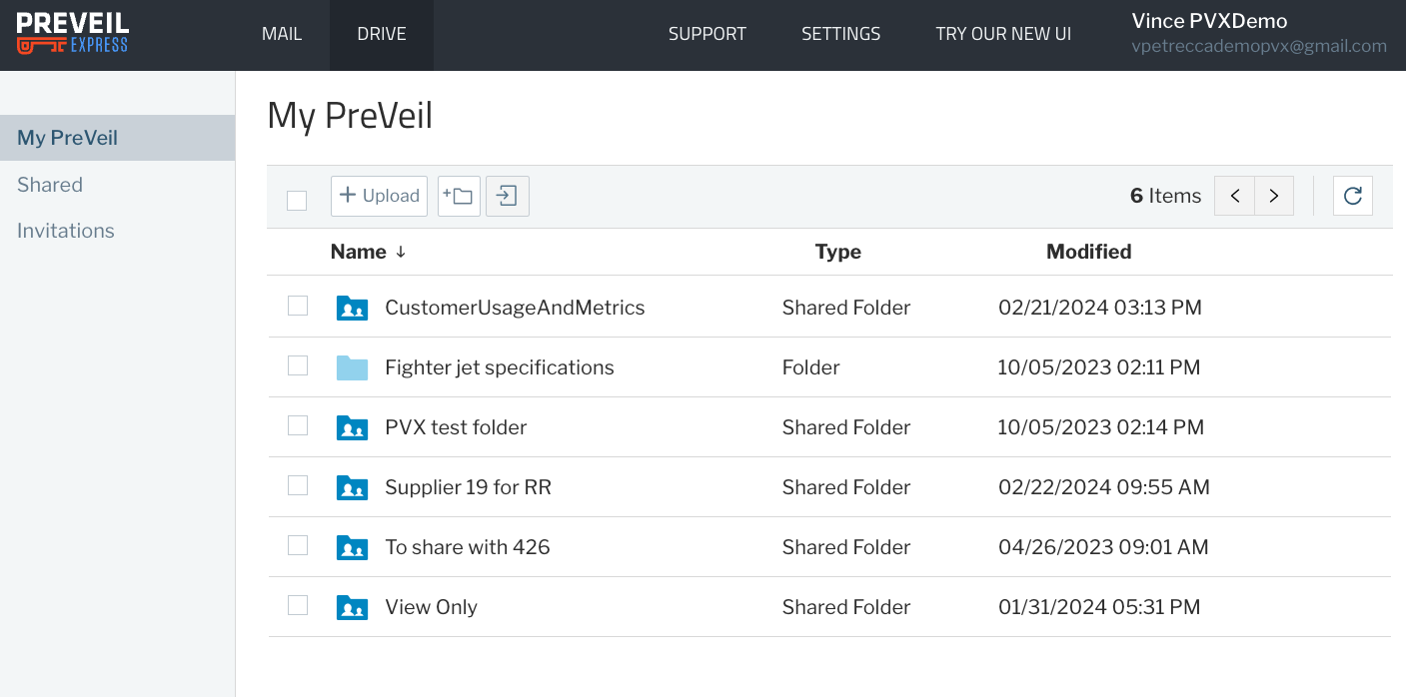
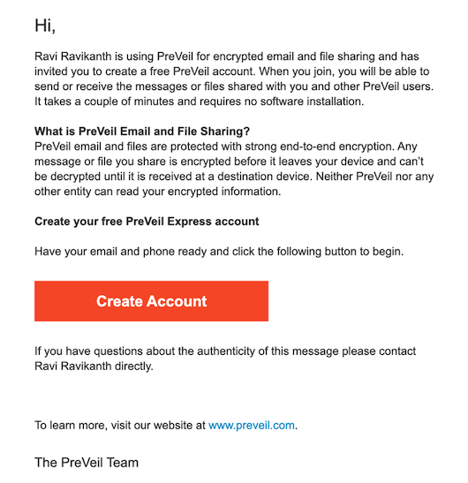
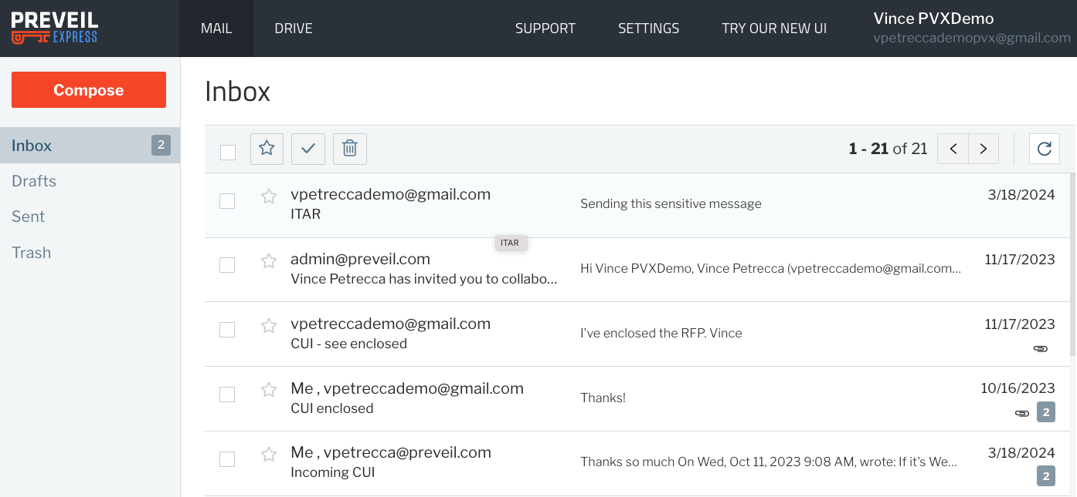
PreVeil Express Portal Access is free for 3rd Parties
Your logo here
Automatic invitation generated and delivered
Takes 1-2 minutes for set up the first time
Fully browser based—no software install
Same secure, end to end encryption
Free for PreVeil customers and unlimited # of 3rd parties
No Guest accounts to manage or pay for
CONFIDENTIAL & PROPRIETARY
8

Slide 10

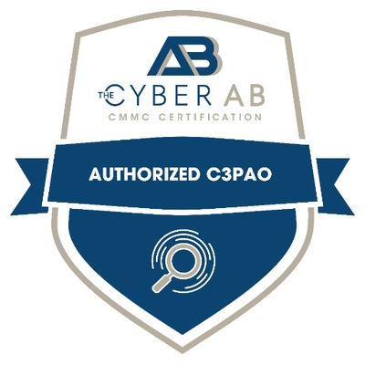




PreVeil has 2000+ defense contractor customers
Your logo here
Used by the Top 10 Primes and all US military agencies
Over 50 PreVeil customers have received perfect 110/110 scores on CMMC assessments
Need help preparing for CMMC?
Need help preparing for CMMC?
Need help preparing for CMMC?
Reaction Engines found PreVeil to be the perfect solution for transferring CUI and large files to other businesses, due to ease of use, the stringent recovery process, and ability to invite contacts into the secure environment.
Switching to PreVeil for cybersecurity, compliance packages, and 1-on-1 compliance support saves this venture builder 40% annually.
SME Defense Contractor Receives 110/110 in CMMC Joint Surveillance Assessment
A 300-employee defense contractor using PreVeil achieved a maximum 110/110 NIST 800-171 score in a rigorous audit conducted under the Joint Surveillance Voluntary Assessment program.
The C3PAO intends to issue a CMMC Level 2 Certification once rulemaking establishes CMMC.
Need help preparing for CMMC?
Need help preparing for CMMC?
This MSP and Registered Provider Organization (RPO) recommends PreVeil to their clients because the unmatched security, ease of use, and cost savings.
How PreVeil enabled MEC2 to get compliant, bid on government contracts that include CUI, and securely share the drawings with subcontractors, at a fraction of the cost of GCC High.
CONFIDENTIAL & PROPRIETARY
11

