Slide 1


Co-Brand Ready PreVeil Slides
A complete, cost-effective solution to CMMC compliance

Slide 2
Your Logo Here
What Partner Does 1
What Partner Does 2
What Partner Does 3
Details
Details
Details
CONFIDENTIAL & PROPRIETARY
4

Slide 3

Why [Partner] (value prop)
Value Prop 1
Value Prop 2
Value Prop 3
Details
Details
Details
CONFIDENTIAL & PROPRIETARY
3

Slide 4

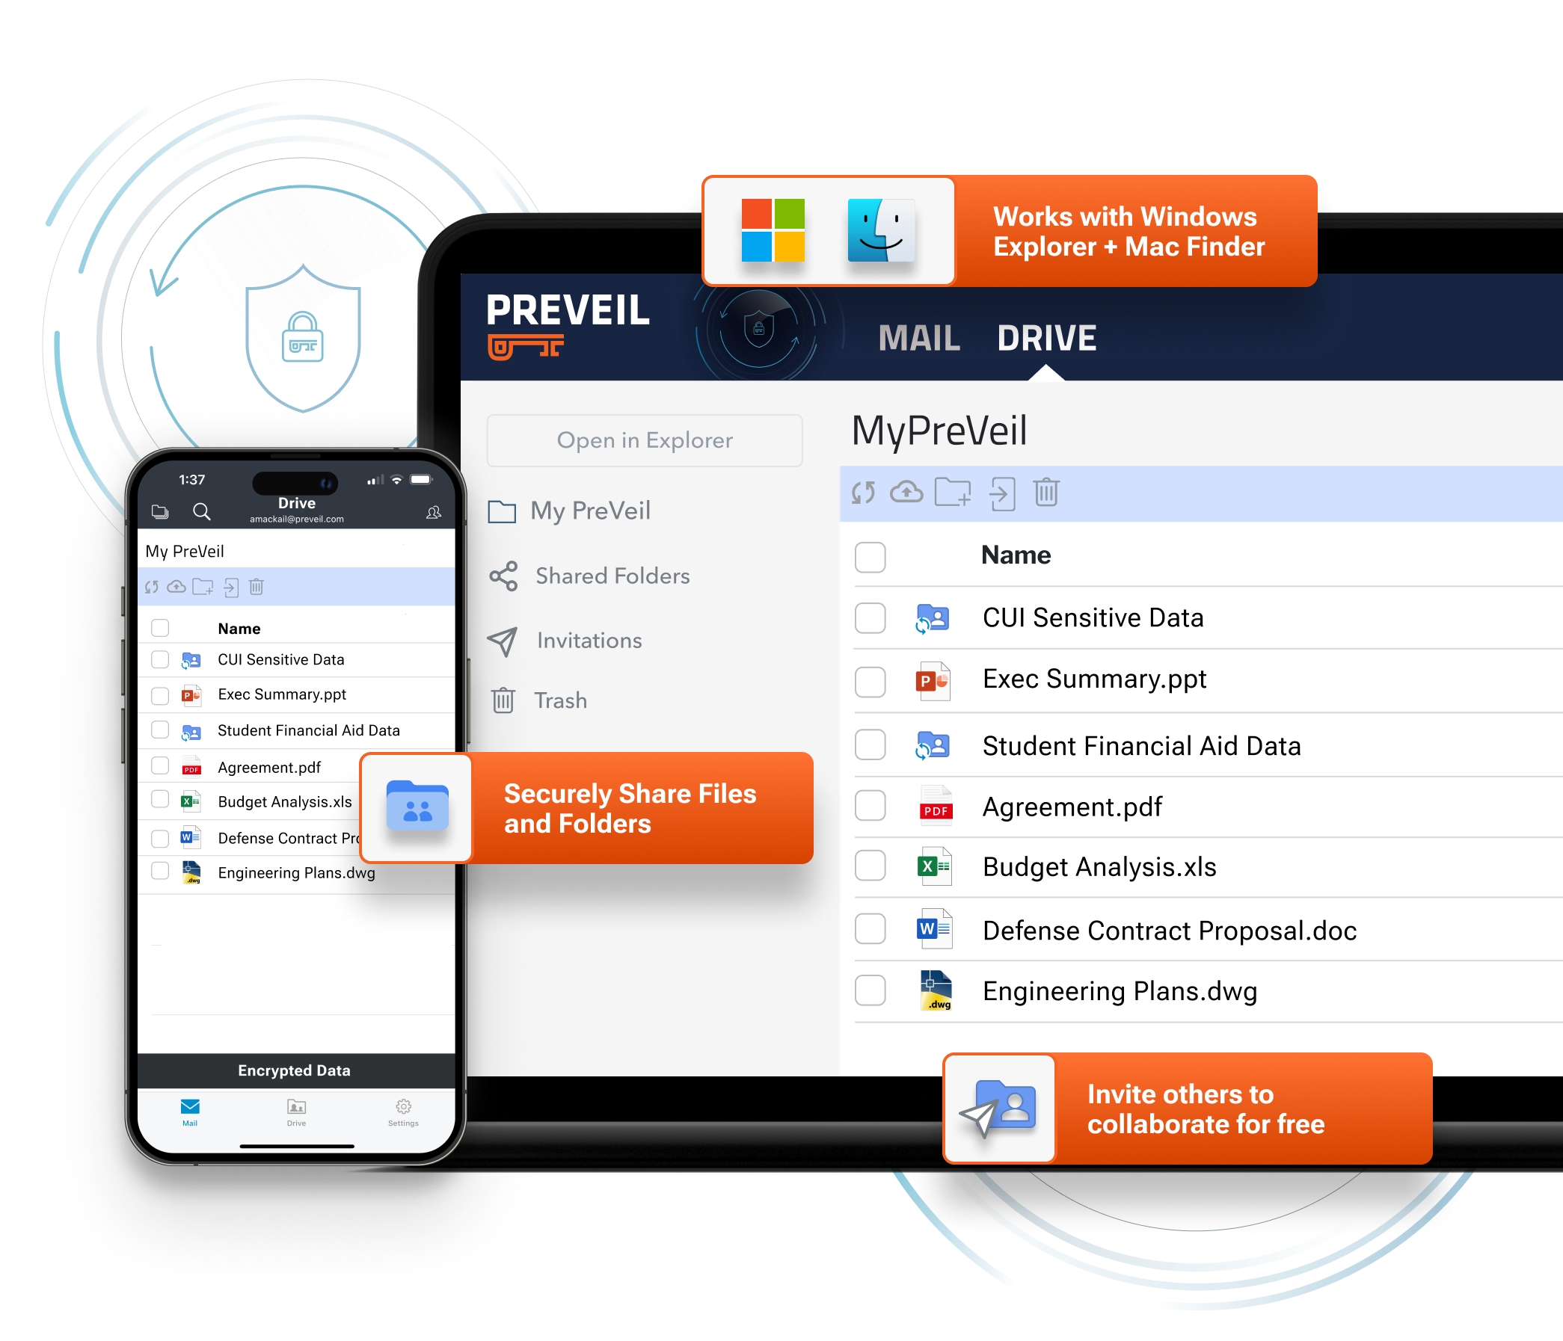
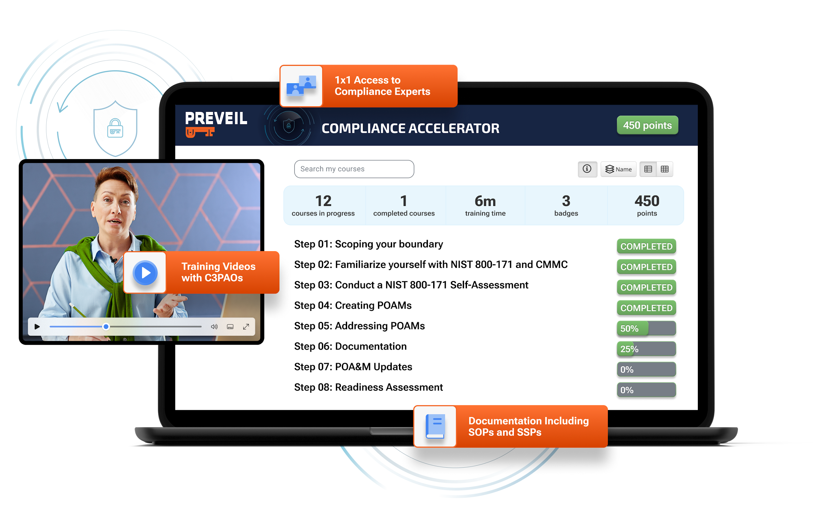

Simple, Secure, Compliant
Email + File Sharing
Assessment-Ready CMMC
Documentation with 1x1 Support
PreVeil Certified Partners: Consultants, MSPs, Assessors
Supports all 110 controls
Save time and money with partners that were vetted by PreVeil
Meets FedRAMP Moderate Equivalent,
FIPS 140-3, DFARS c-g, ITAR
CONFIDENTIAL & PROPRIETARY
4

Slide 5




Why PreVeil
Easy to Deploy
and Use
Proven
Compliance
Save 75% vs Alternatives
Deploys in a few hours using your existing email addresses
Integrated w/ Outlook, Gmail, Windows Explorer, Mac Finder
Meets all DoD DFARS & CMMC requirements
3,000 DIB customers,
75+ with 110/110 CMMC assessment scores
Minimize the compliance boundary to only users handling CUI (enclave)
Leverage PreVeil’s Compliance Accelerator
Alternatives
PreVeil
License + Documentation Cost
CONFIDENTIAL & PROPRIETARY
3

Slide 6
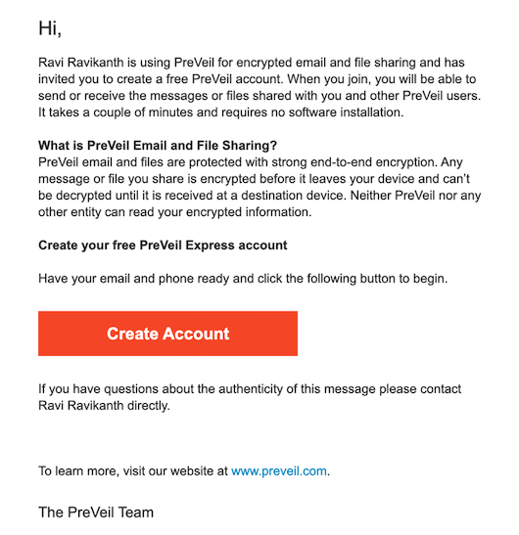
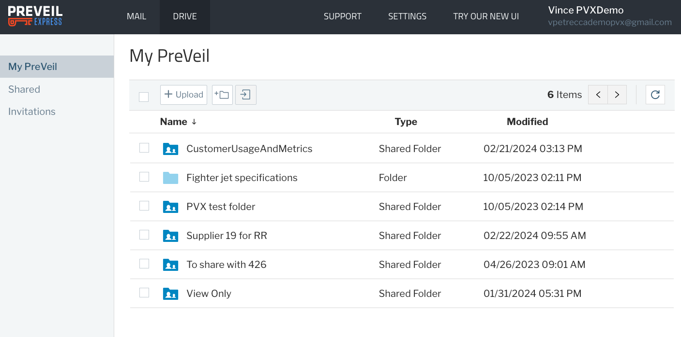
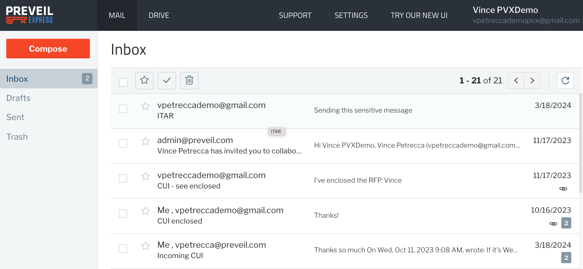
Free Access for 3rd Parties to PreVeil Express Portal
Automatic invitation generated and delivered
Takes 1-2 minutes for set up the first time
Fully browser based - no software install
Same secure, end to end encryption
Free for PreVeil customers and unlimited # of 3rd parties
No Guest accounts to manage or pay for
CONFIDENTIAL & PROPRIETARY
8

Slide 7
[Your Company] & PreVeil
PreVeil
[Your Company]
[Your Company] Preferred Tech Partner providing encrypted Email + File Sharing for Defense and Regulated Industries
Provide pre-filled documentation and assessment prep tools which saves time preparing for CMMC assessment
Proven: 75+ Contractors have received 110/110 CMMC scores leveraging PreVeil

Slide 8
Thank You
[Your logo here]
PreVeil.com
skrepps@preveil.com
Partner website
Partner email
CONFIDENTIAL & PROPRIETARY
8

